Slide 1
React22S : JavaScript
Overview

Slide 2
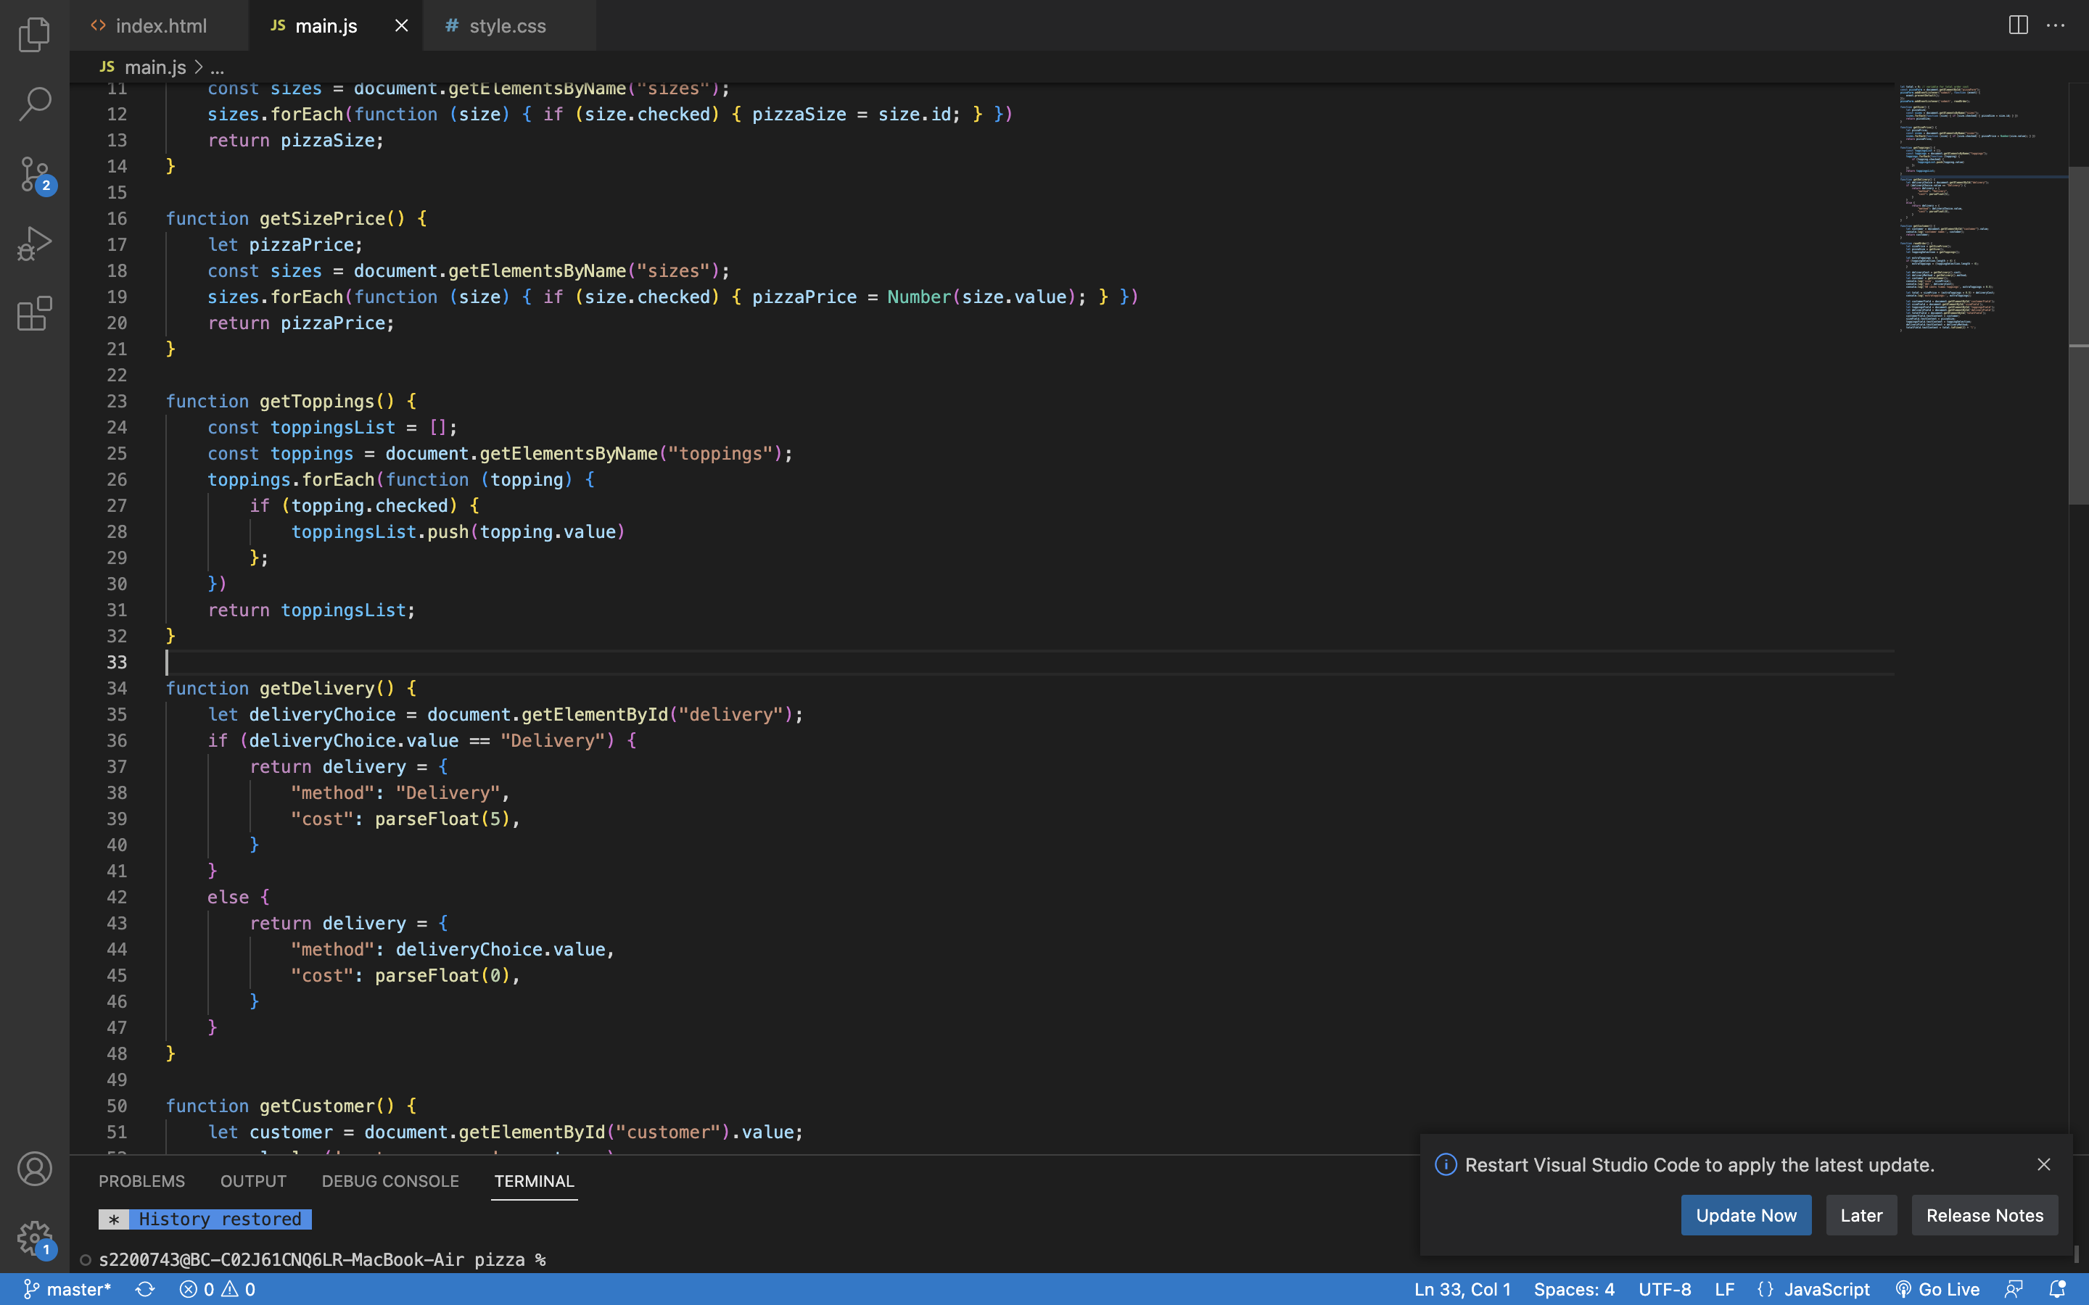
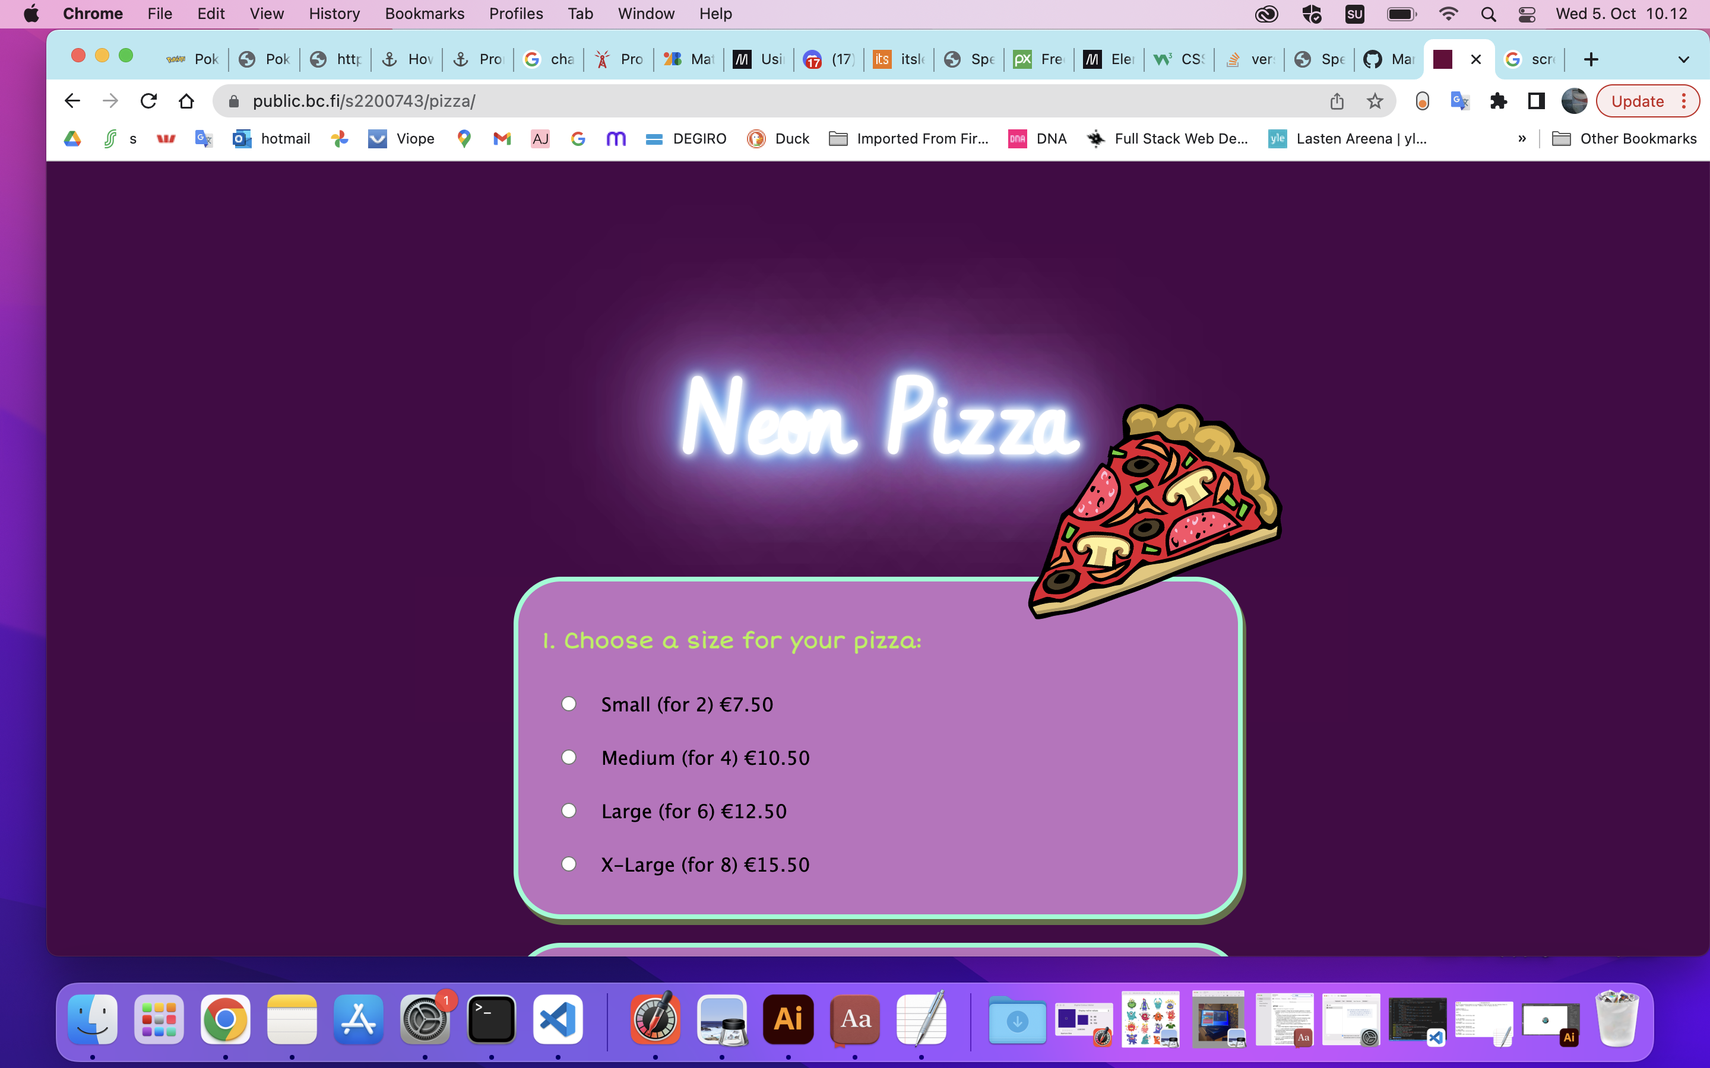
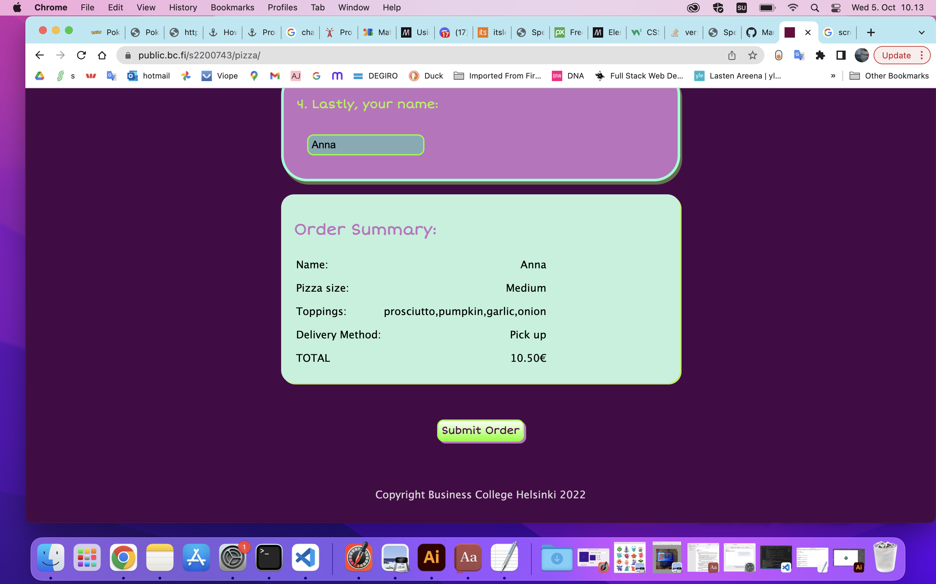
Pizza
Summary:
Getting a suitable image was surprisingly difficult. I had never used the <form> tag before and was very confused about how it worked at first.
The Toppings function took me the longest to get working but was good practice with loops and Nodelists.

Slide 3
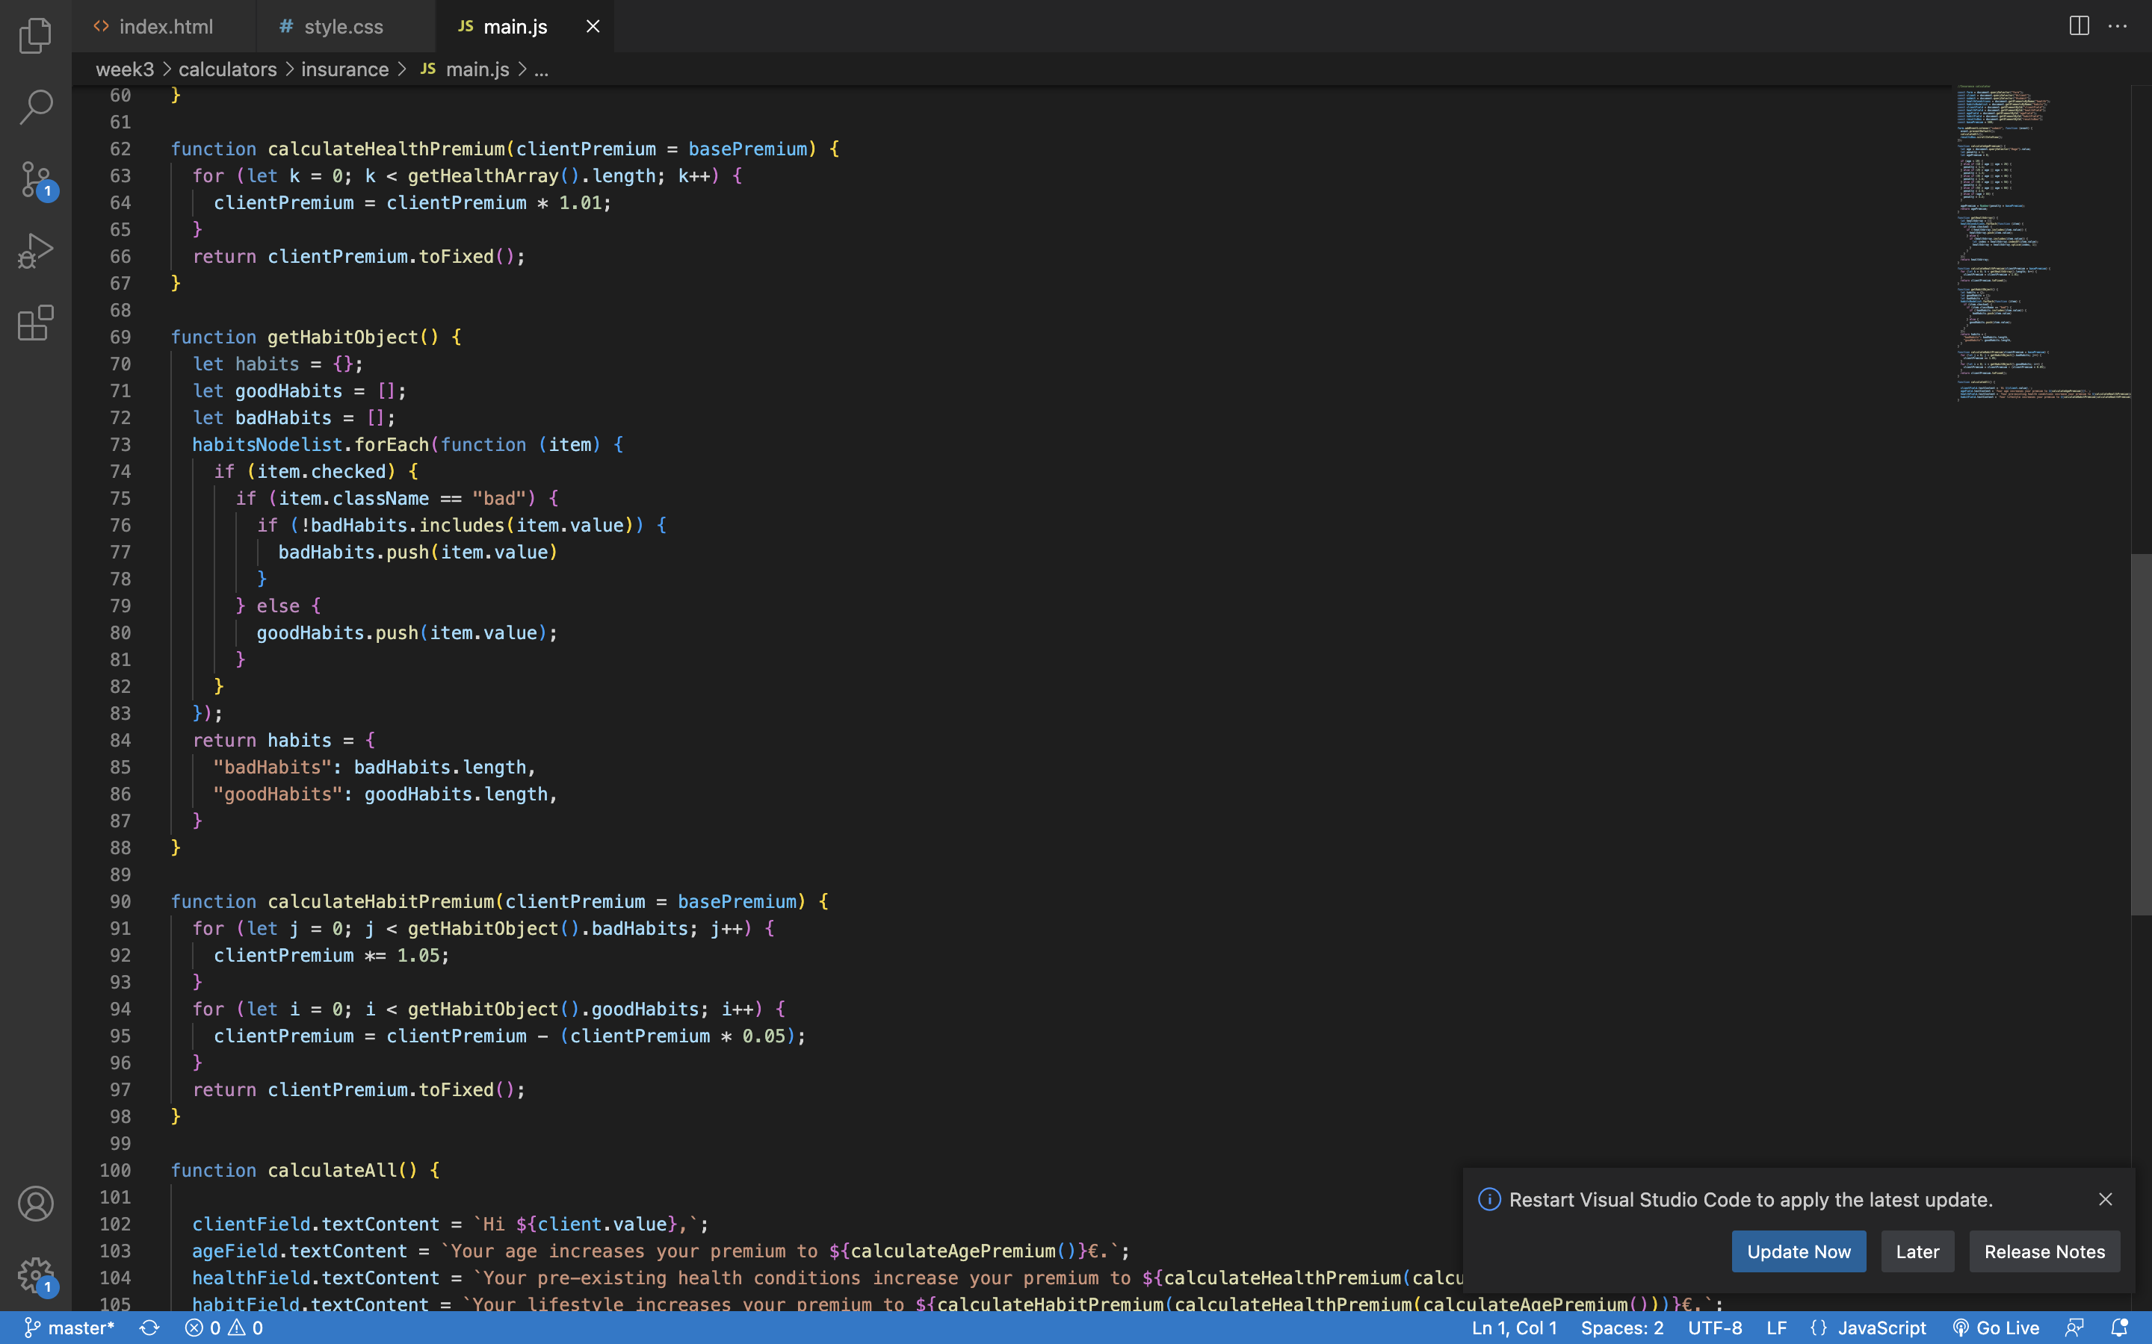
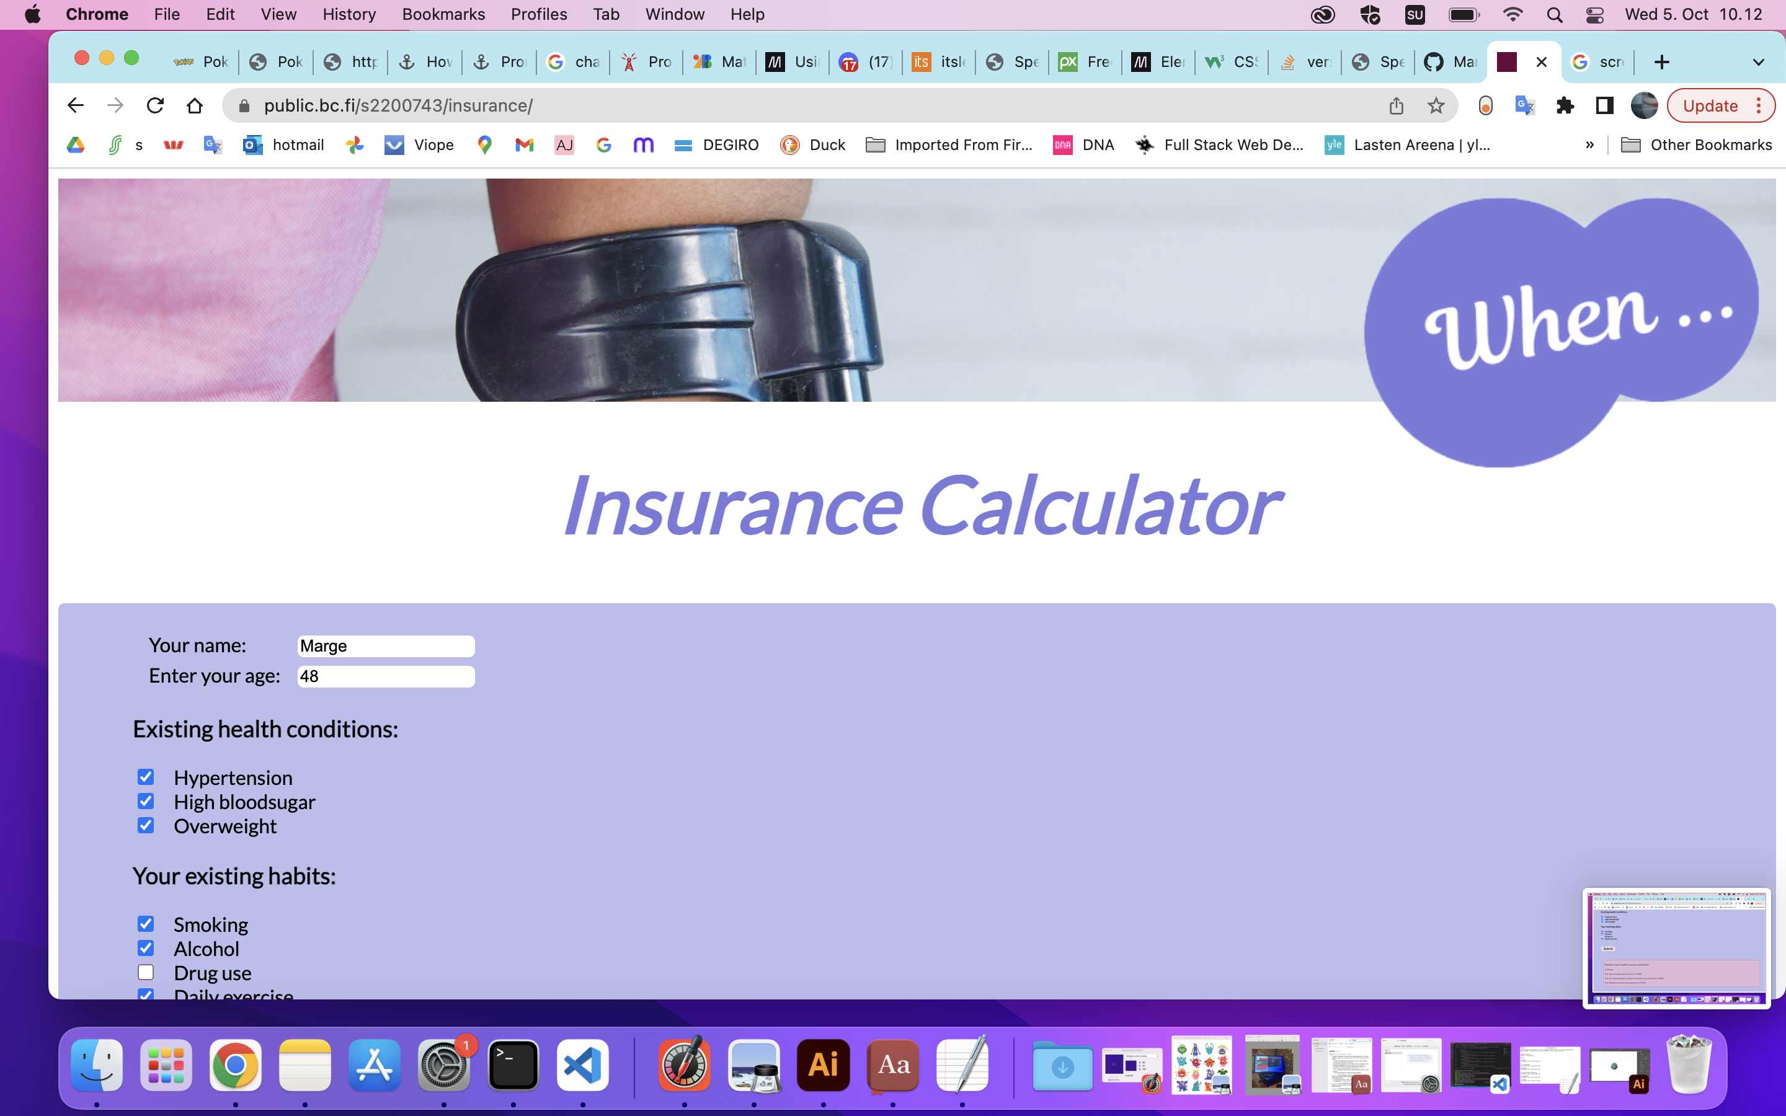
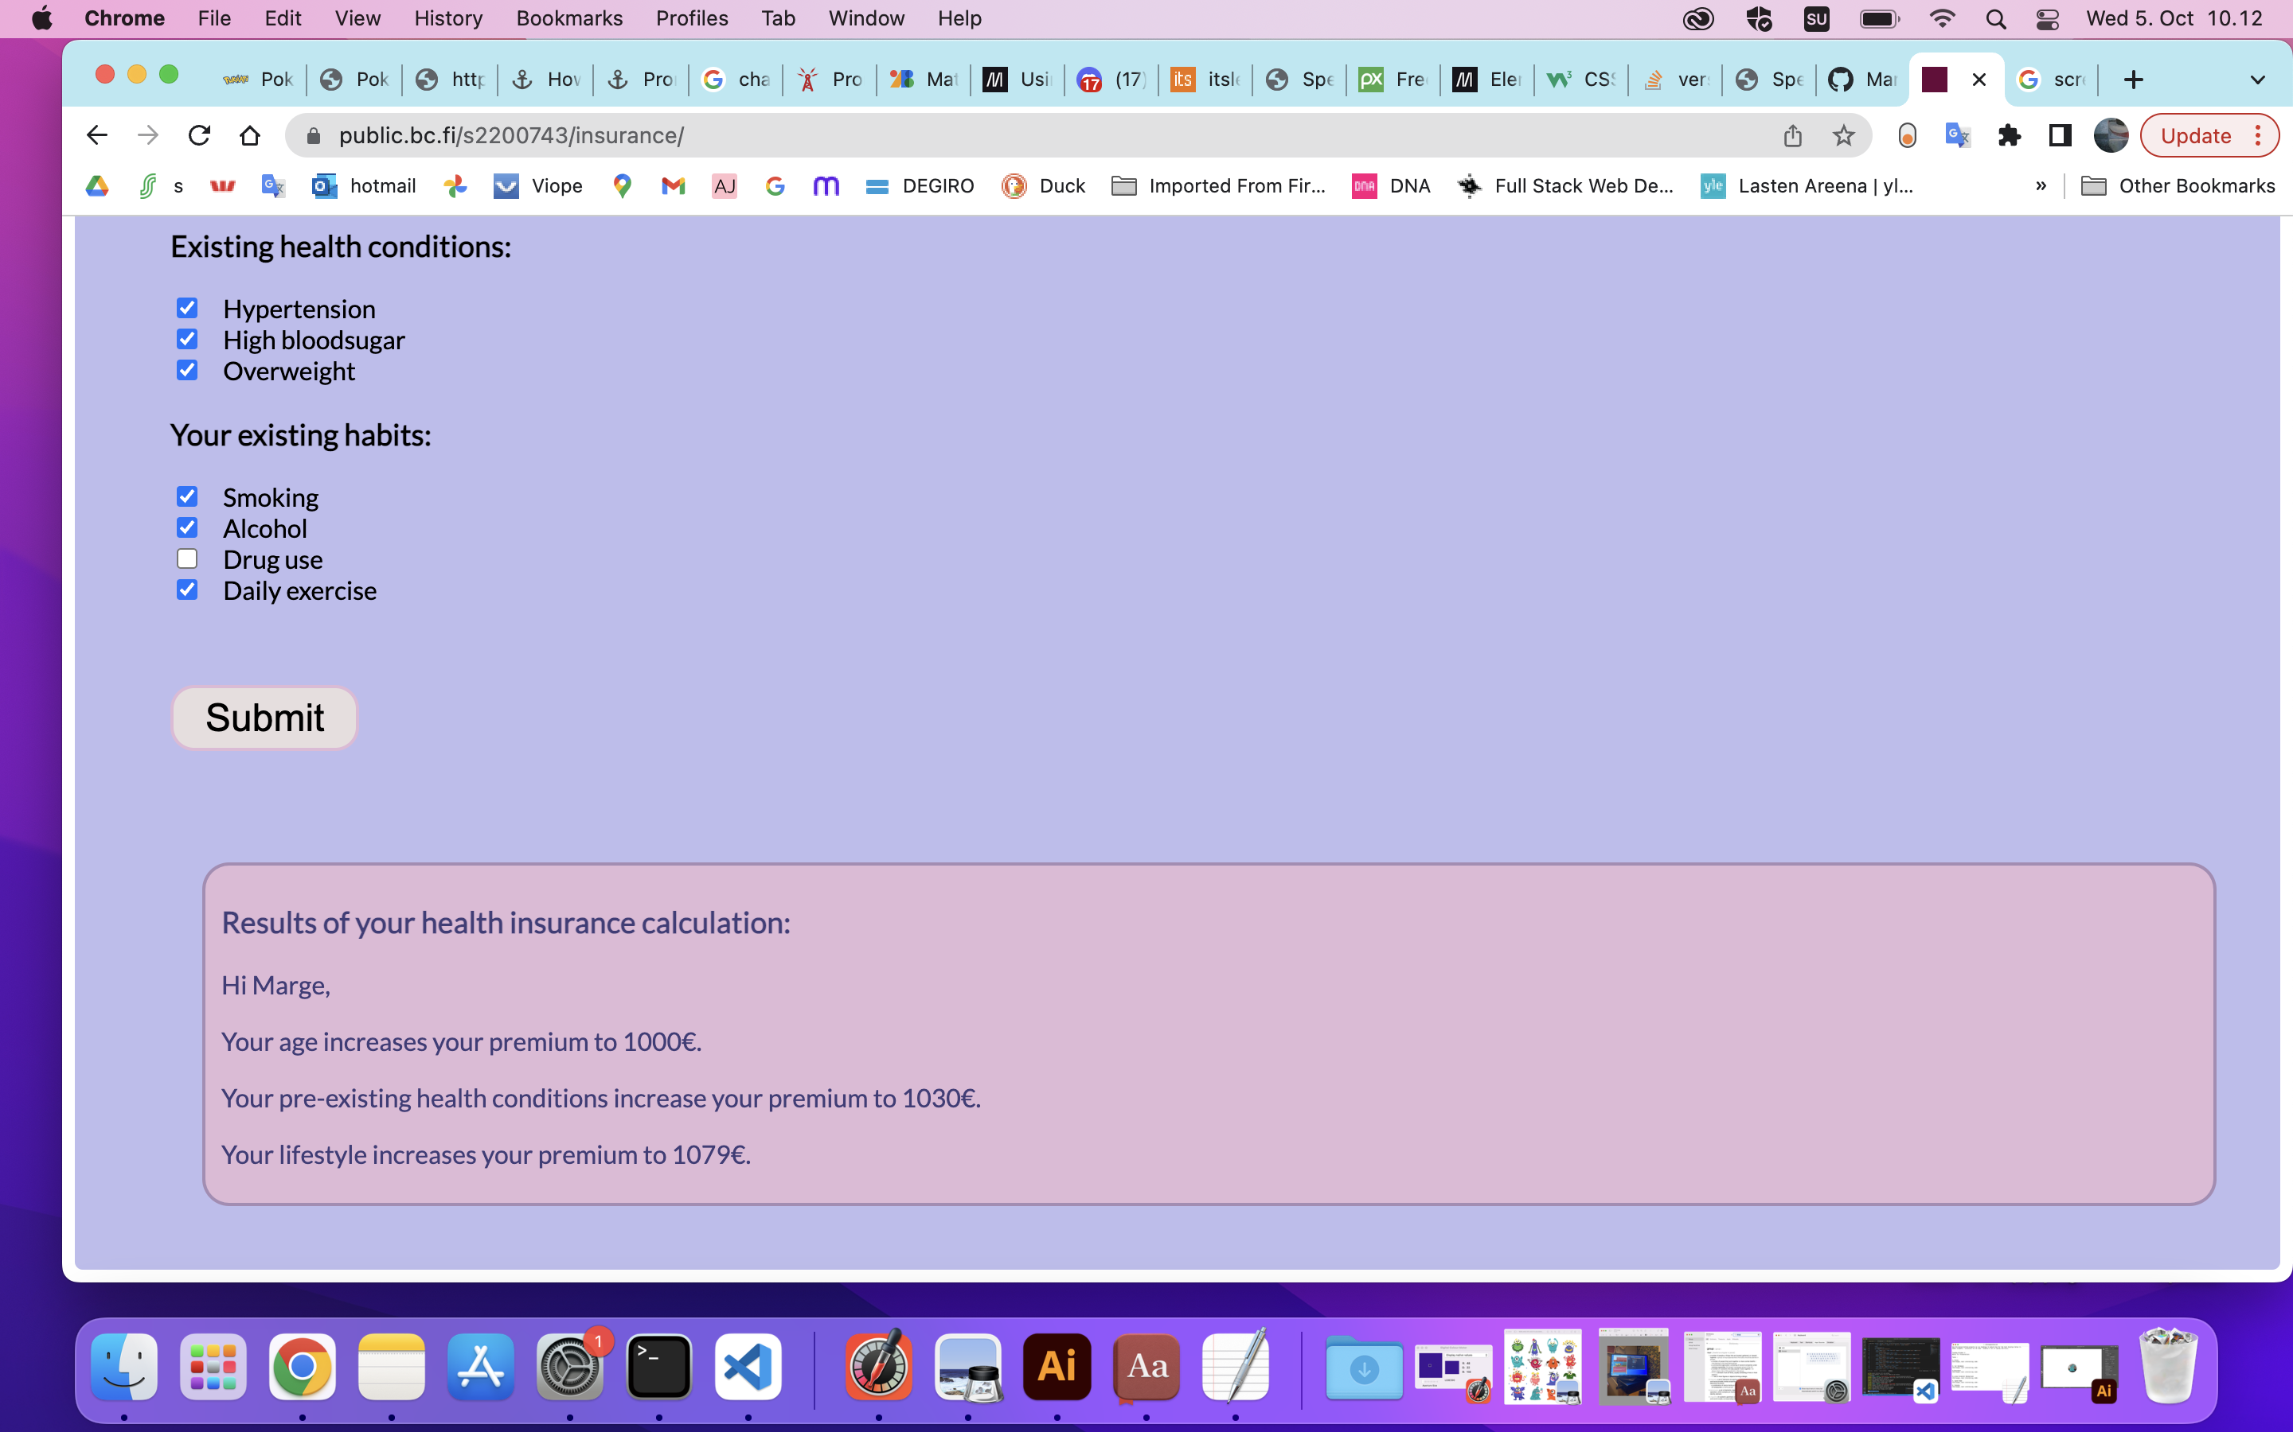
Insurance
Summary:
Logic was ok;
Stuggled with understanding how to get all the user inputs, at first. And CSS.

Slide 4
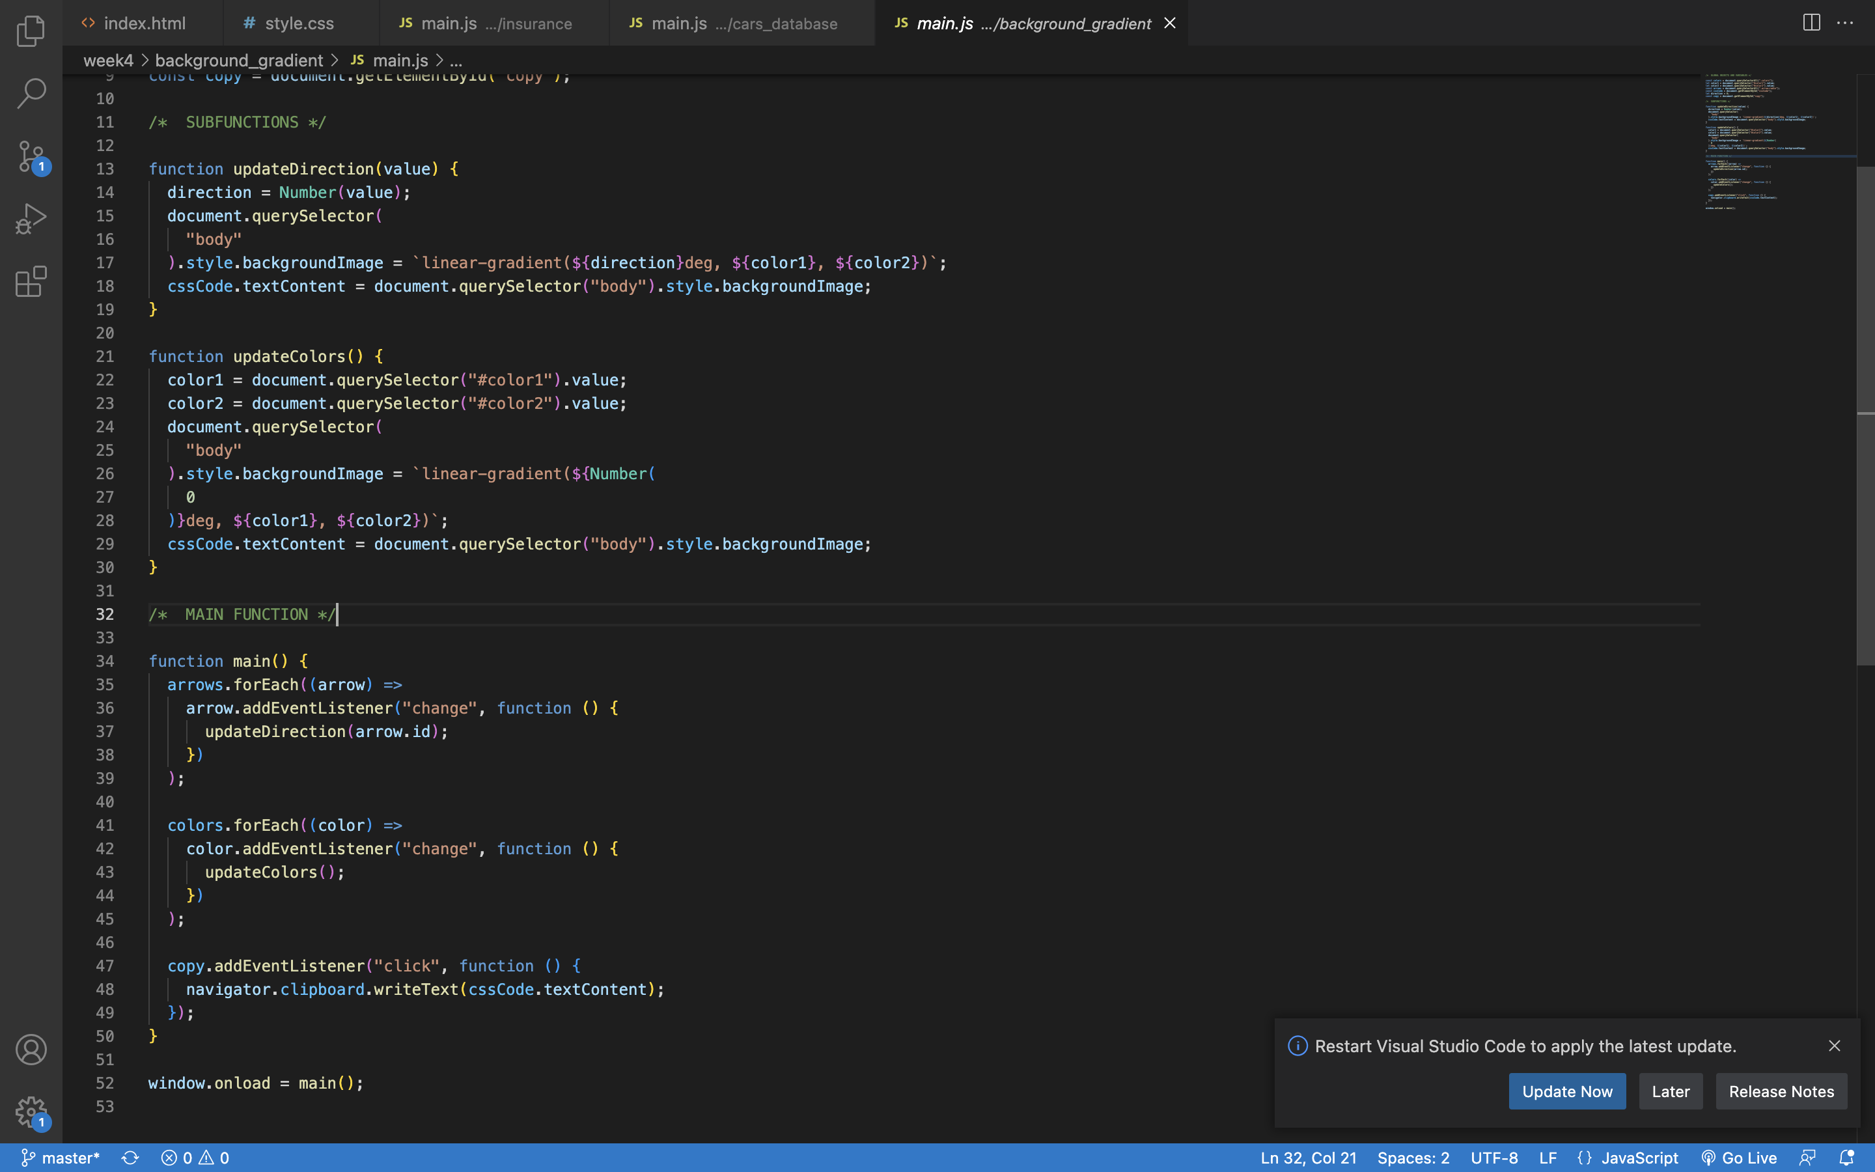
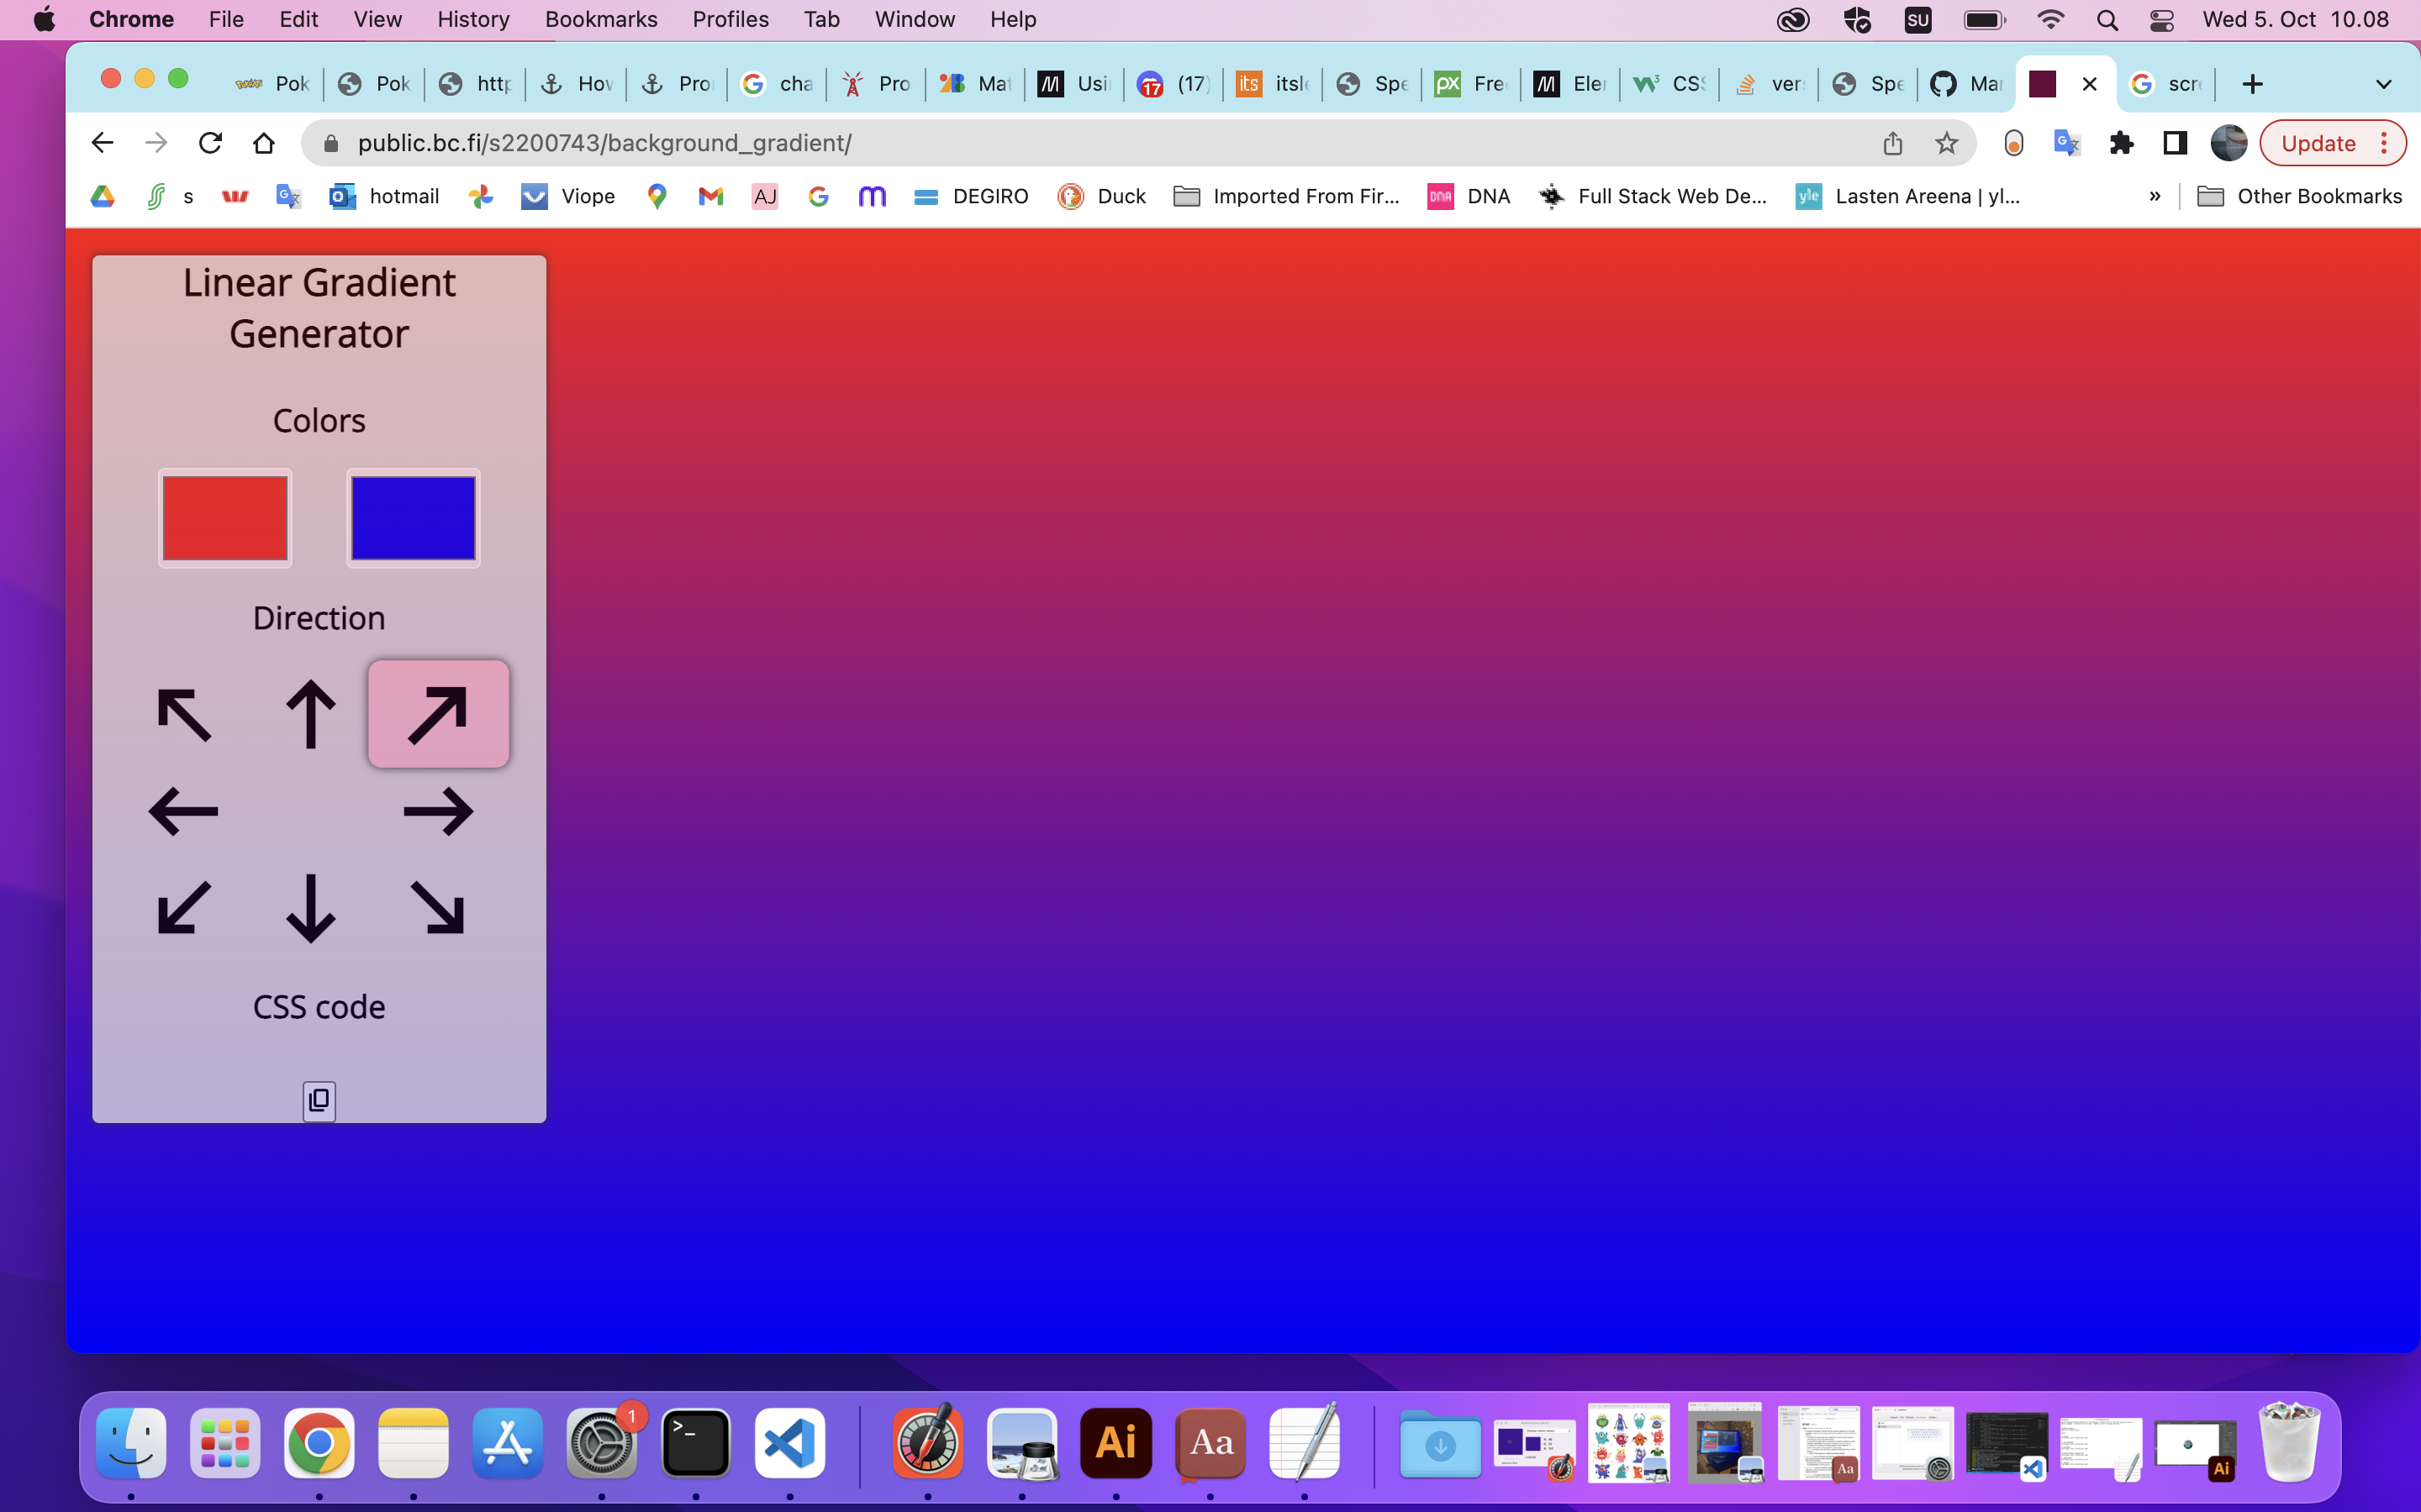
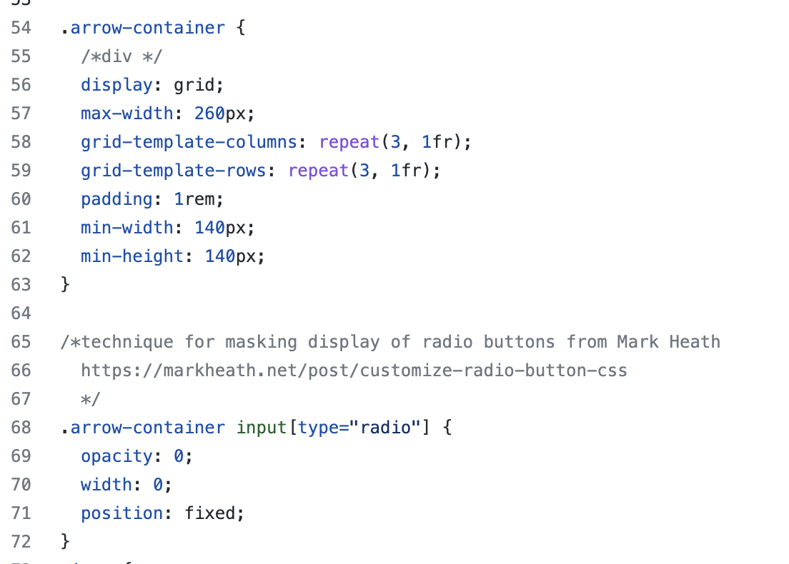
BG Generator
Summary:
Not as difficult as feared.
Used invisible radio buttons inside labels inside spans to create arrows, with grid display, and an empty label in the centre.

Slide 5
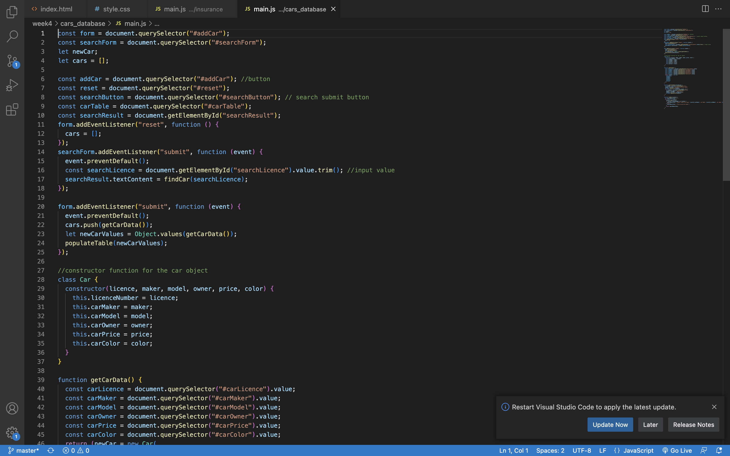
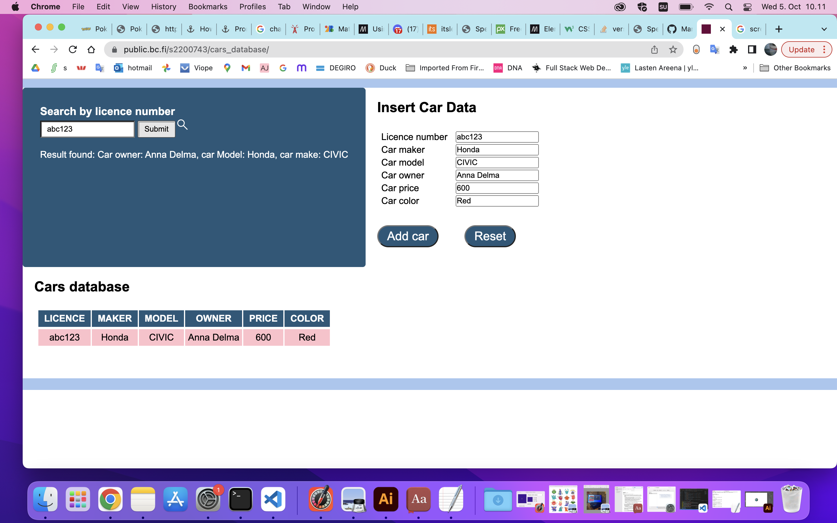
Cars Database
Summary:
I was rather proud of the function I made to generate the table. I was stuck on the search function for a long time because I couldn’t get the includes() function to work…I just wrote a loop in the end.

Slide 6
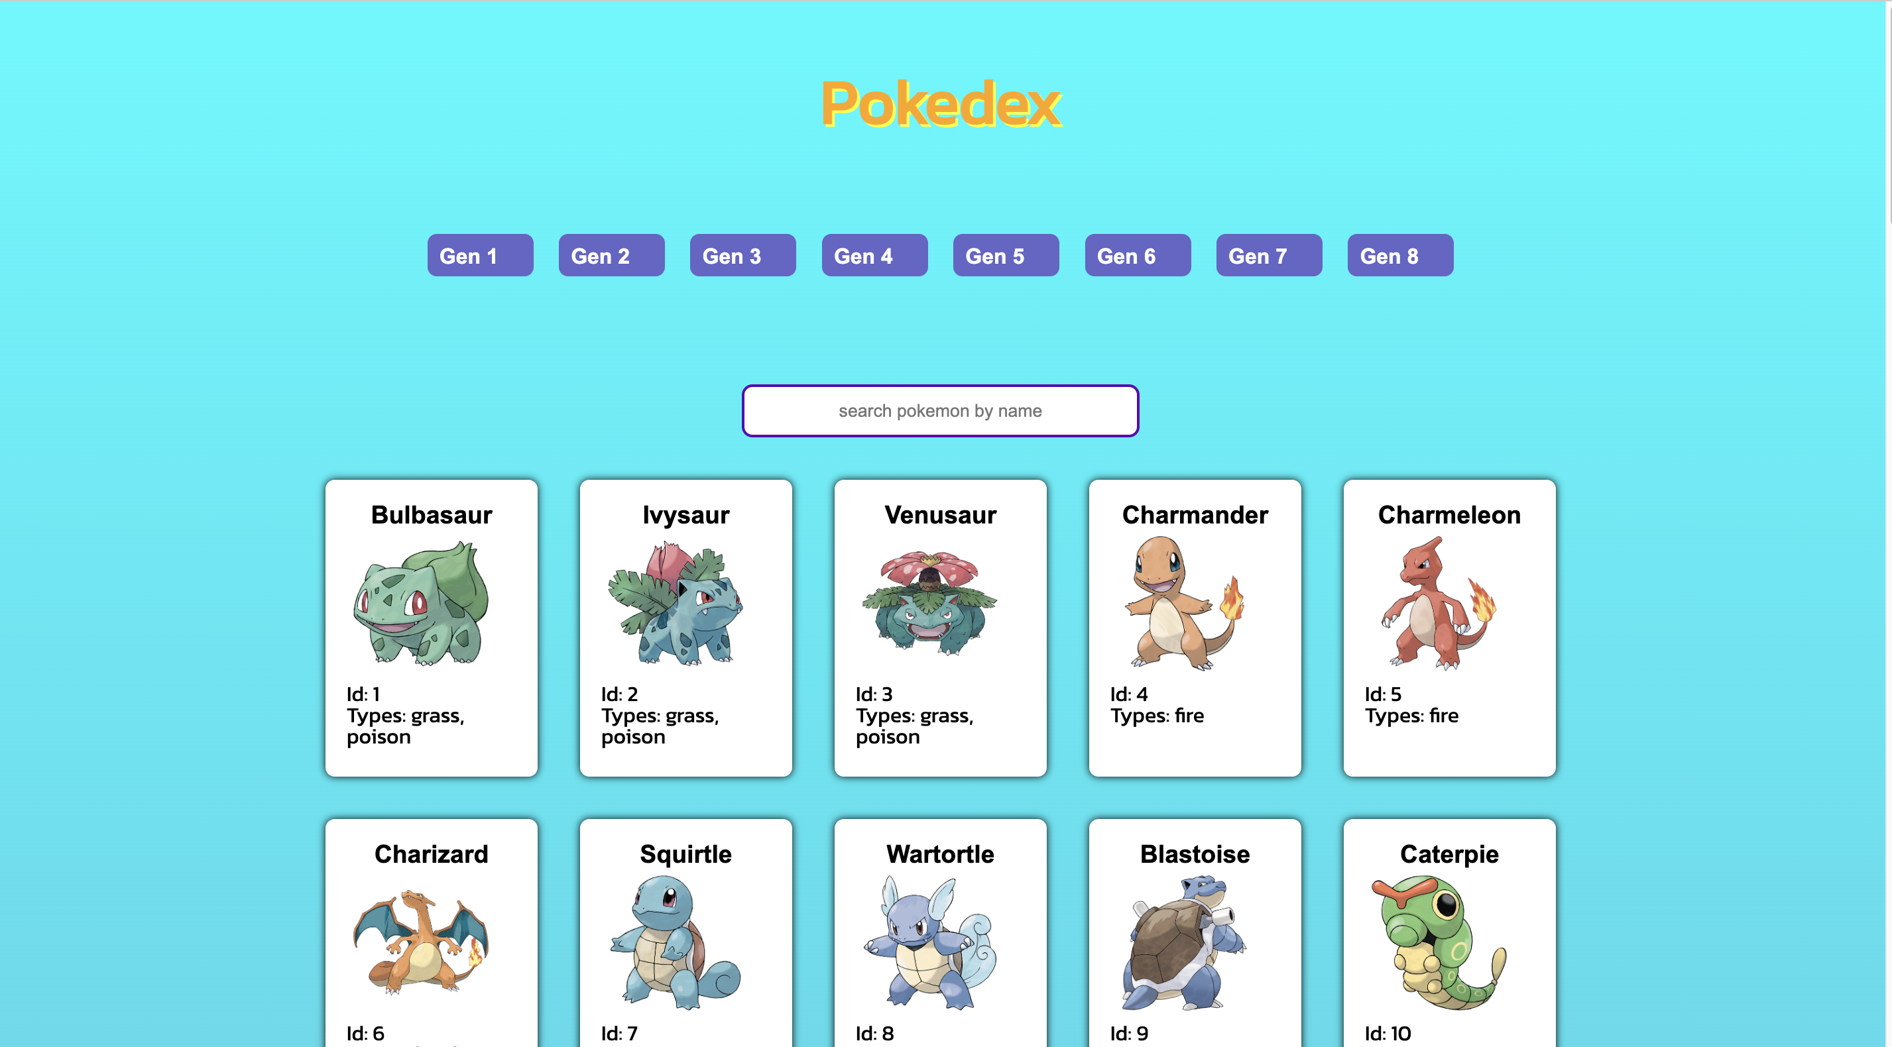
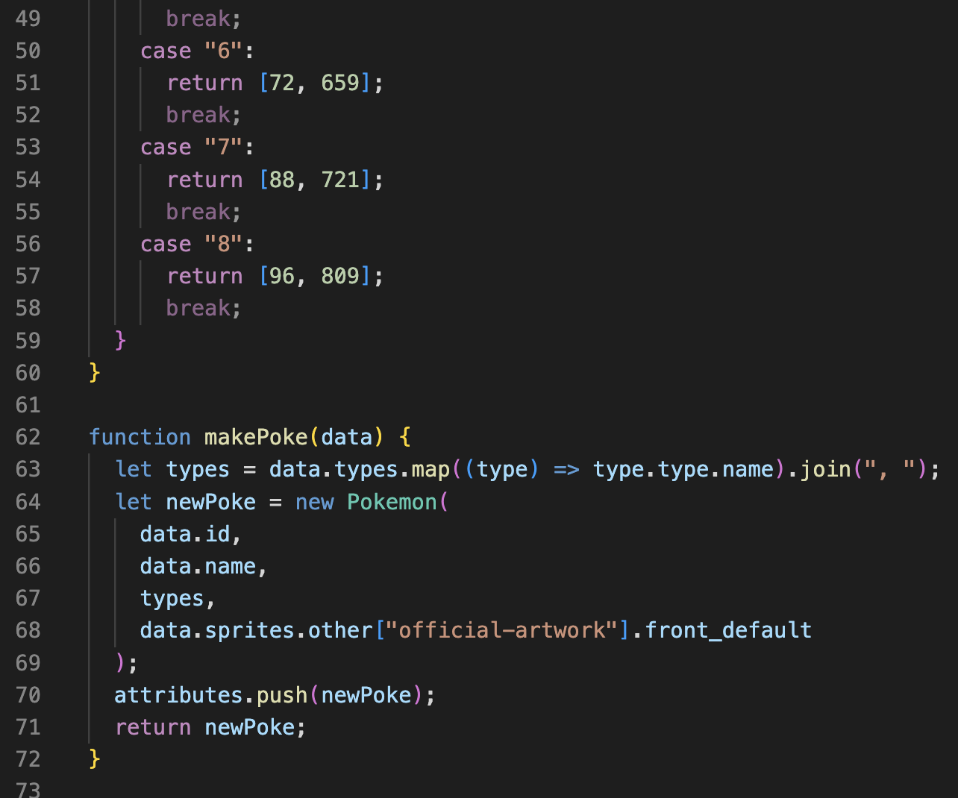
Pokedex
Summary:
The hardest part was the promises; I didn’t really understand how to use them. They seemed to take too long to resolve, so that the values weren’t available in time for all the other functions. I had to ‘cheat’ by inserting a a few timeouts(), but I think that the way I am fetching the data is very clumsy and inefficient.

Slide 7
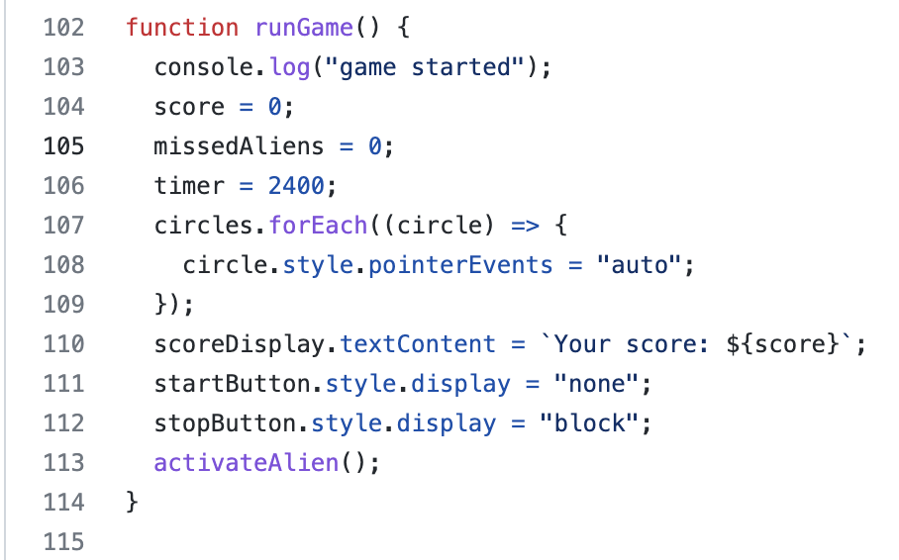
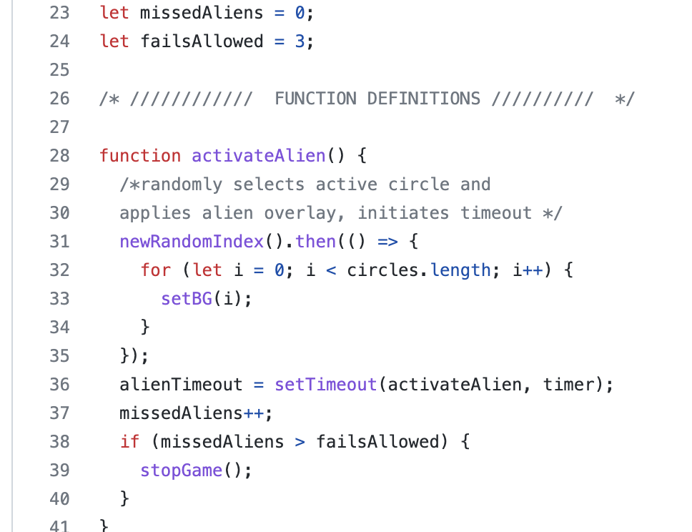
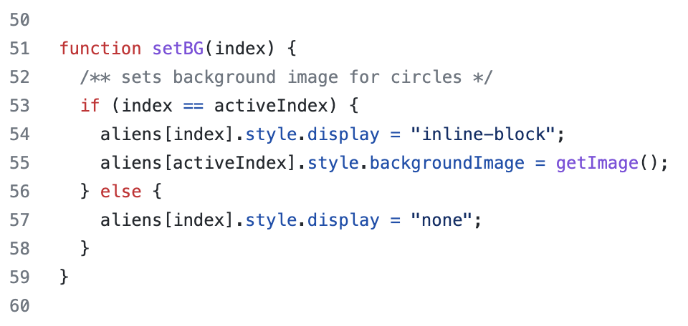
Speed Game
Summary:
This also took me a really long time to get working. Among other things, was stuck on getting the game to end if an alien wasn’t clicked; actually it was really easy and obvious how to do with just a variable!
I used overlayed divs
To display the active circles, rather than toggling a class.

Slide 8
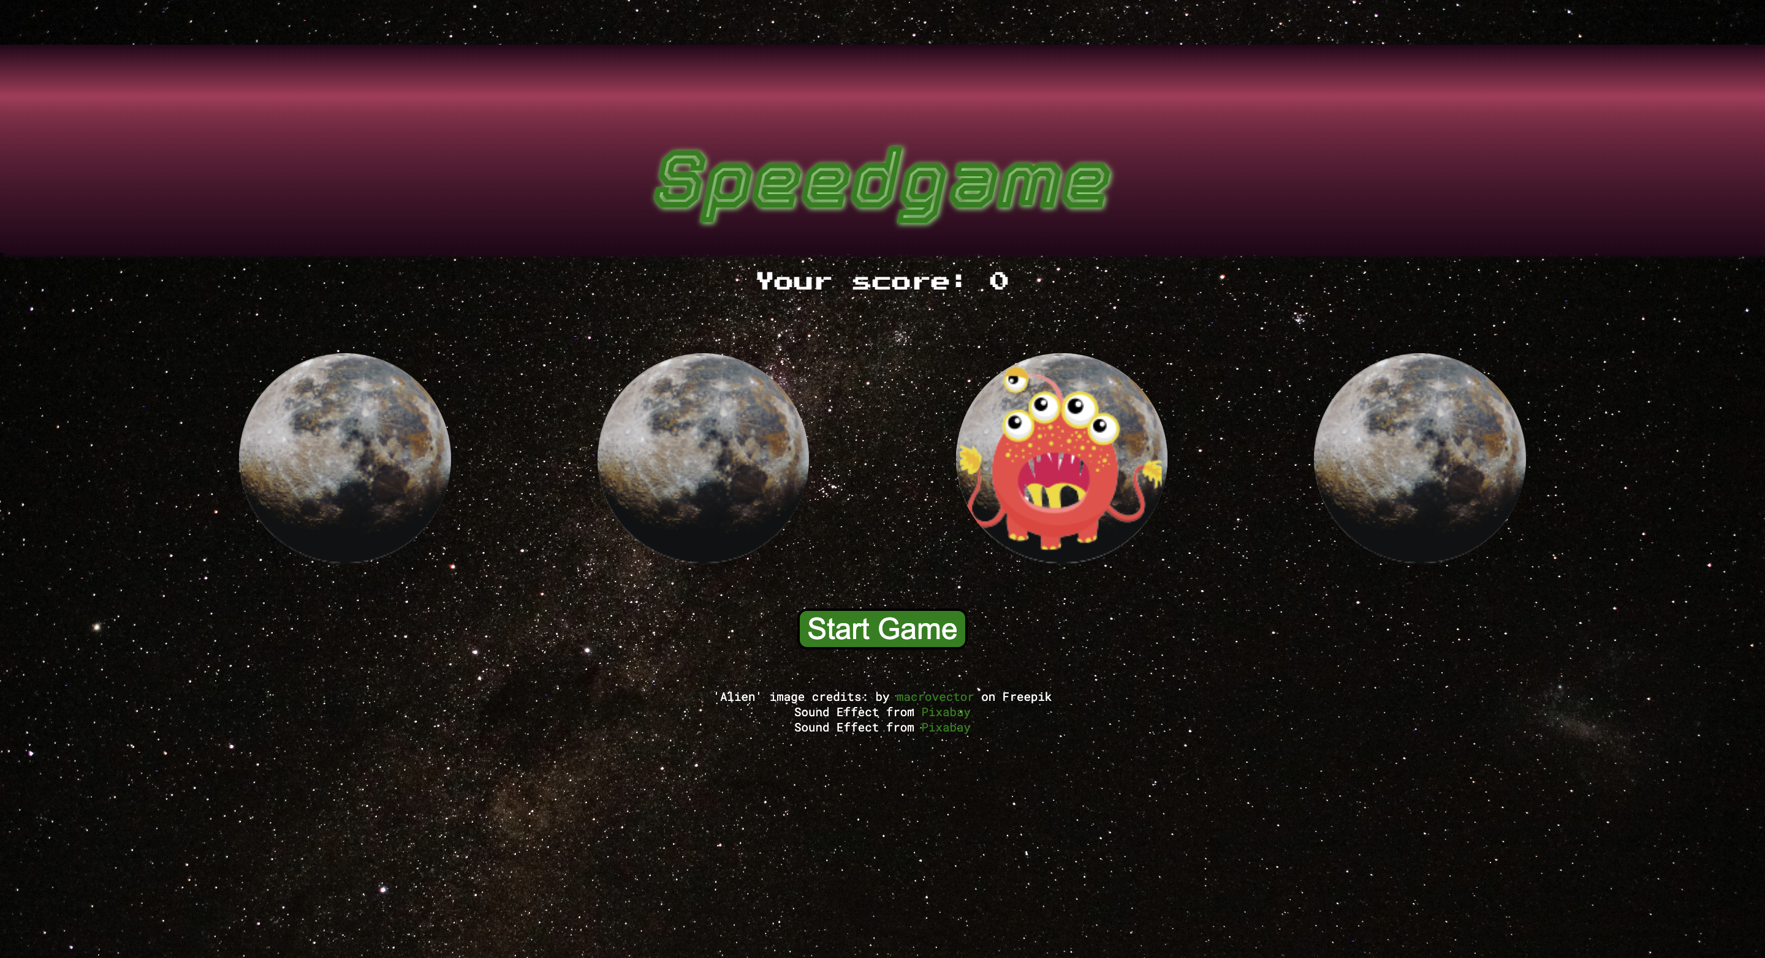
Speedgame
Link to live game: https://public.bc.fi/s2200743/Speedgame

